Slide 1
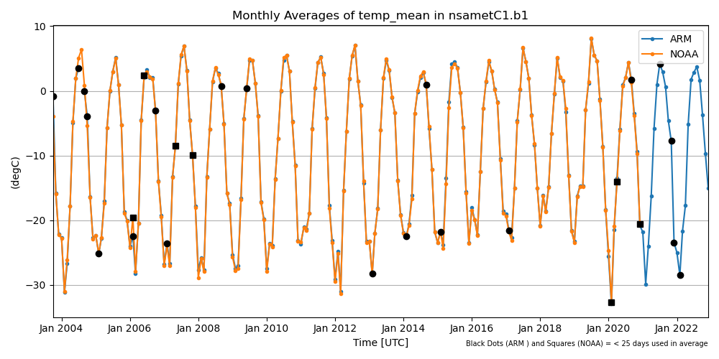
ARM Climatologies: An Experiment in Open Paper Development
erhtjhtyhy
Adam Theisen
Adam Theisen

Slide 2
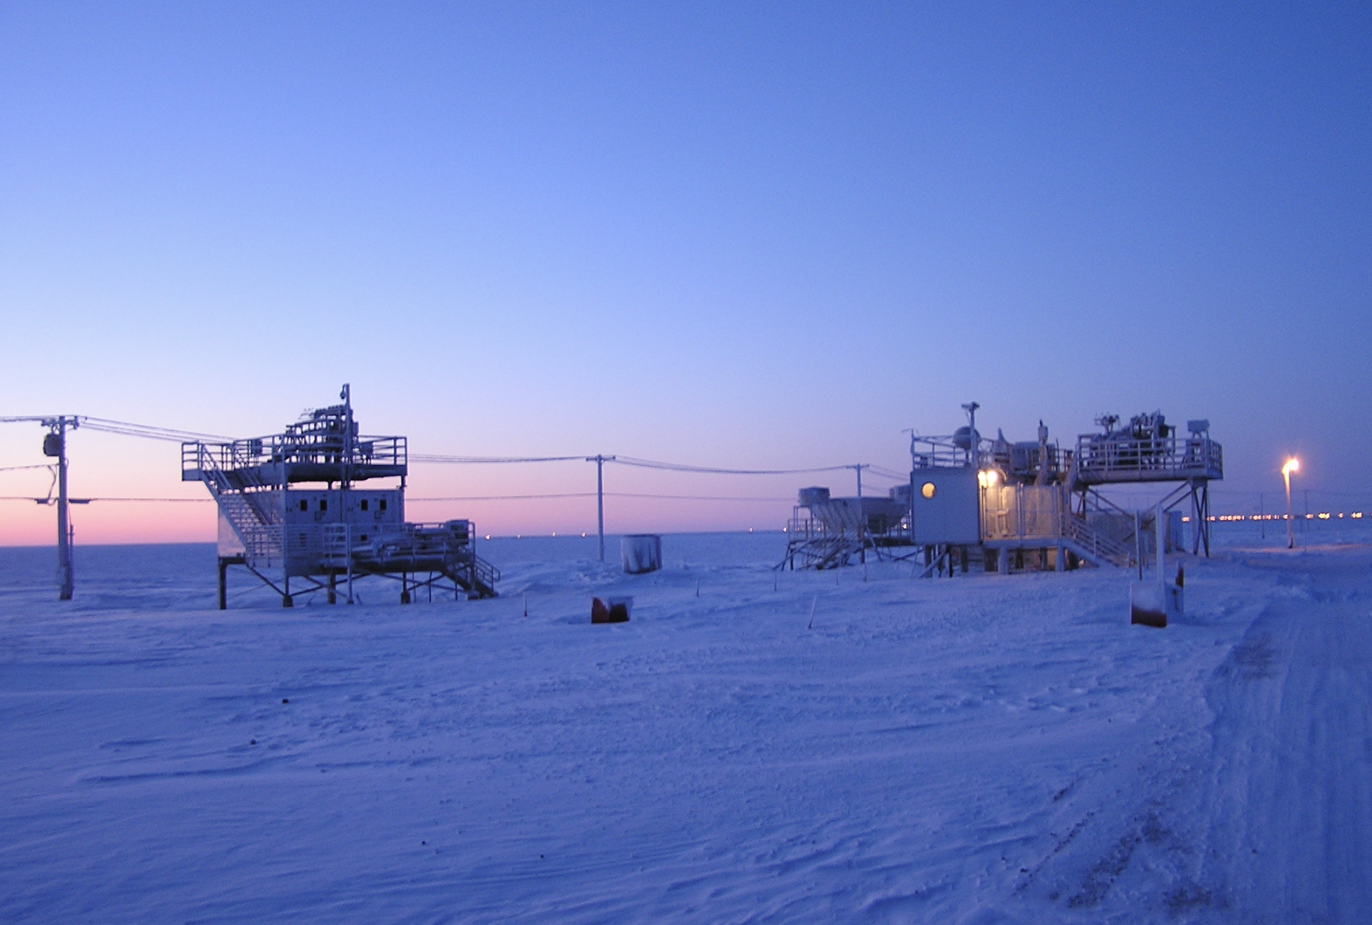
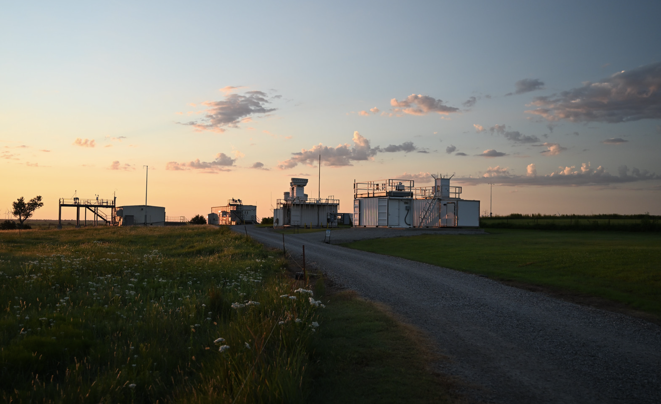
background
NSA: 1997
ARM has a wealth of historical data
Papers have been published on climatologies of various measurements but once published, those climatologies end
Can we create a citable reference source for climatologies that are updated on a yearly basis?
Image courtesy of the U.S. Department of Energy Atmospheric Radiation Measurement (ARM) user facility.
SGP: 1993
Image courtesy of the U.S. Department of Energy Atmospheric Radiation Measurement (ARM) user facility
Photo by Nicki Hickmon, Argonne National Laboratory

Slide 3
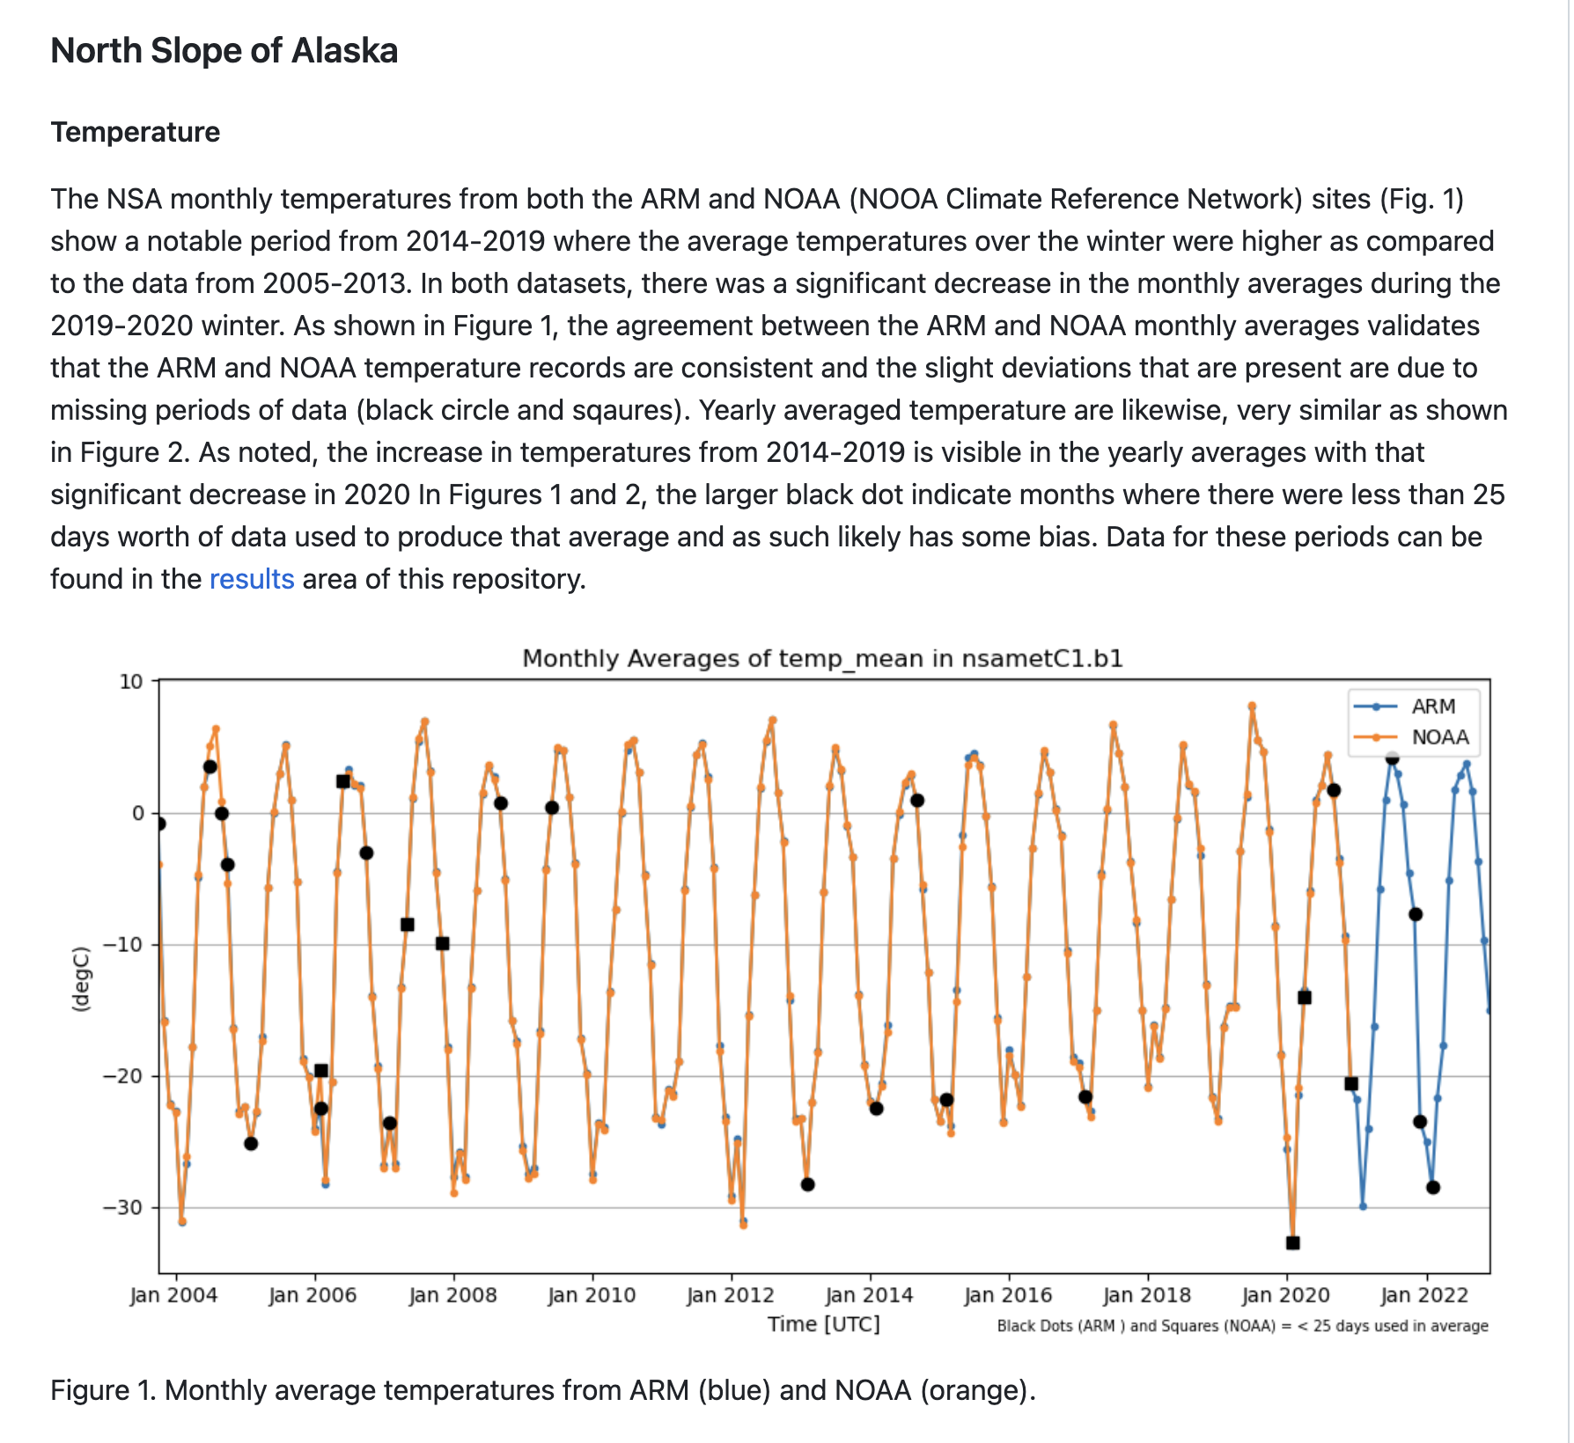
Github Repository
ARM-Climatologies
Using GitHub functionality we can
Add authors through pull request contributions
Create DOIs through Zenodo that auto-update with each new release
Provide open access and open reviews
https://github.com/AdamTheisen/ARM-Climatologies

Slide 4
Structure
Codes and Processing
Repository
Codes
Readme
Images
Results
ARM Research System
Process historical dataset
Push updates to Repository
arm_climatologies.py
Processes all data for monthly or yearly averages and writes to csv files (xarray)
Applies DQRs and QC to remove all bad and suspect data
plot_climatology*.py
Various scripts to plot up the data in different views
README.md
Contains the article text and formatting

Slide 5


Structure
Contributions and Reviews
Contributions can be accepted through the standard GitHub pull request process
All contributors get added as Authors
Reviews are the hard part!
How do we solicit and track peer reviews to give this process more weight?
Discussions?

Slide 6

Results
NSA Climatologies
Surface Temperature
Precipitation
In Progress
NSA Surface RH
SGP (T/RH/Precip)
Kyrouac, J., & Shi, Y. Surface Meteorological Instrumentation (MET). Atmospheric Radiation Measurement (ARM) User Facility. https://doi.org/10.5439/1786358
NOAA Climate Reference Network (60NOAACRN). Atmospheric Radiation Measurement (ARM) User Facility.

Slide 7
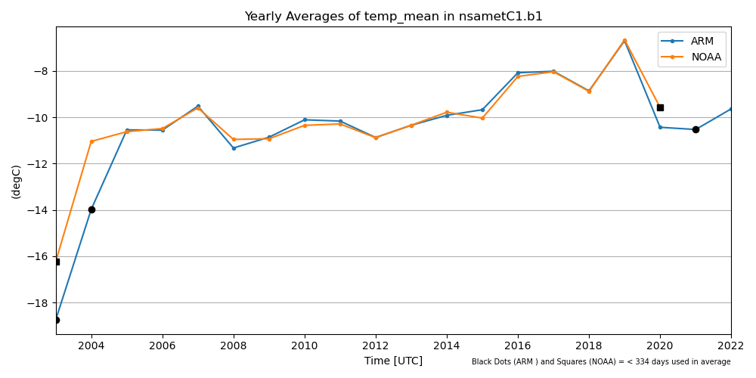
NSA
Temperature – Yearly Average

Slide 8
NSA
Temperature – Monthly Average

Slide 9
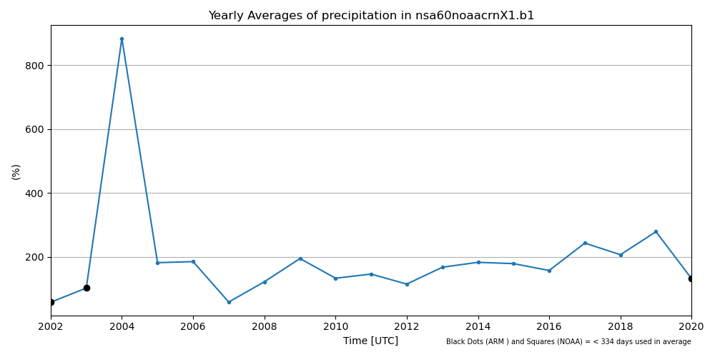
NSA
Precipitation – Yearly Average (NOAA Weighing Bucket)
Bad Data?

Slide 10
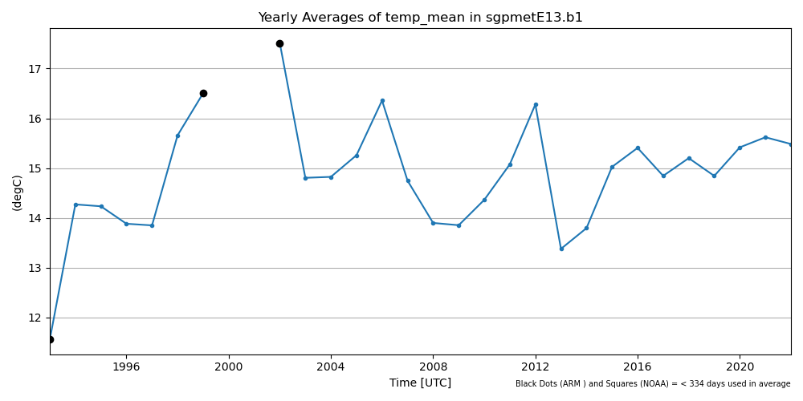
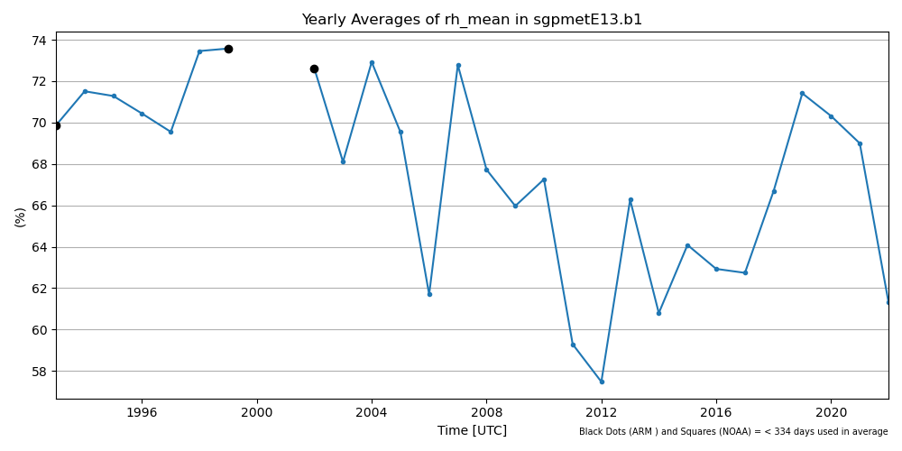
SGP E13
Yearly Temperature and RH
Significant warm years in 2006 and 2012 followed by periods of relatively lower temperatures
Yearly average temperature is more steady in recent years

Slide 11

Summary
ARM-Climatologies repository showcases a way to provide routinely updated climatologies in a citable source by using GitHub
Generally update the data in January for the previous year
Idea is to eventually automate the processing and commit to GitHub
Open for collaborations, additions, reviews, etc…
Future steps are to expand to other sites/measurements

Slide 12
Questions?

